Slide 1
Testing React Applications
Introduction to web testing
Getting started with Vitest
Using Vitest to test React applications

Slide 2
Section 1: Introduction to Web Testing
The traditional approach to testing web apps
A better approach to testing
Web testing frameworks

Slide 3
The Traditional Approach to Testing Web Apps
Traditionally, developers used to take a manual approach to testing web apps
Look at the web page in a browser, to see if it looks right
Or call alert() many times, to display variable values
What's wrong with this approach?

Slide 4
A Better Approach to Testing
Here's a better approach to testing:
Write a formal test
Run the test to verify successful outcome
Keep test code as well as real code, so you can run the tests again and again as the code evolves

Slide 5
Web Testing Frameworks
Many web testing frameworks have emerged and proved popular over the years, including:
Mocha
Jasmine
Jest
Vitest
We're going to use Vitest
Fast, modern, Vite-native testing framework
See https://vitest.dev/

Slide 6
Section 2: Getting Started with Vitest
Overview
Minimal dependency for Vitest
Writing tests
Running tests

Slide 7
Overview
In this section we'll see a bare-bones example of how to use Vitest to write and run tests
We'll show:
How to install minimal Vitest dependencies
How to write simple tests
How to run tests
See demo-app-1

Slide 8
Minimal Dependency for Vitest
Here's the minimal dependency for using Vitest:
It's also convenient to define the following script entry:
"devDependencies": {
"vitest": "^1.6.0",
…
}
package.json
"scripts": {
"test": "vitest",
…
}
package.json

Slide 9
Writing Tests
Here are some simple tests using Vitest:
Vitest is compatible with the Jest test framework
It uses describe, it, expect, etc. in the same way as Jest
import { describe, it, expect } from 'vitest'
describe('vitest simple example', () => {
it('shows 2 + 2 is 4', () => {
expect(2 + 2).toBe(4);
});
it('shows 2 + 2 is not 5', () => {
expect(2 + 2).not.toBe(5);
});
});
example.test.ts

Slide 10
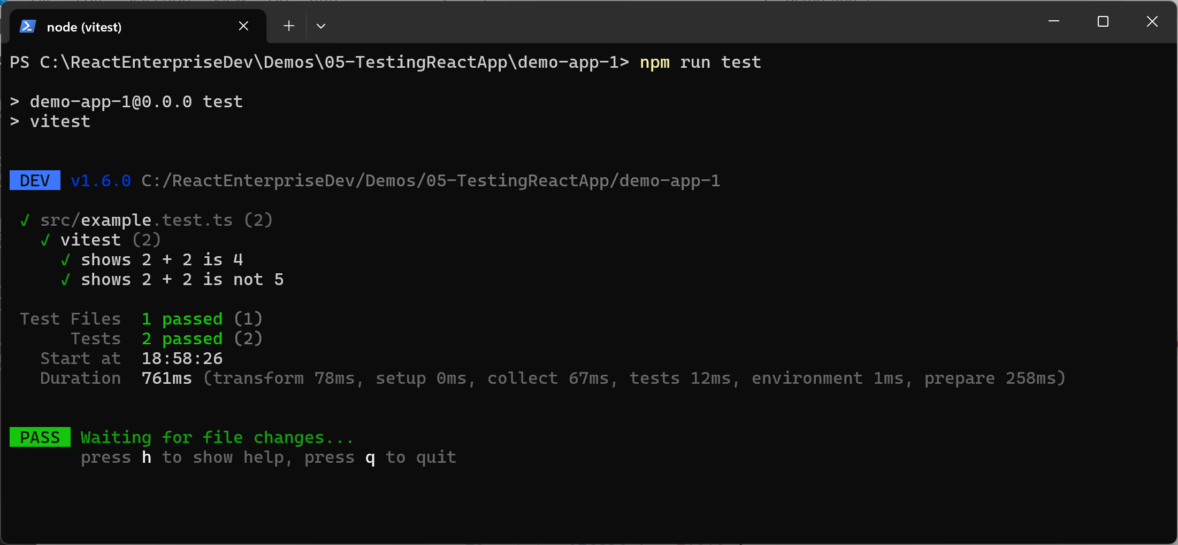
Running Tests
npm run test

Slide 11
Section 3: Using Vitest to Test React Applications
Overview
Full dependencies for Vitest and React
Vitest configuration
Test setup
Writing tests for React
Running the tests

Slide 12
Overview
In this section we'll see how to use Vitest to test React applications
We'll show:
How to install full dependencies for Vitest and React
How to configure Vitest
How to define test setup
How to write and run tests
See demo-app-2

Slide 13
Full Dependencies for Vitest and React (1 of 5)
Here are the full dependencies for using Vitest to test a React application:
The following slides describe these dependencies…
"devDependencies": {
"vitest": "^1.6.0",
"jsdom": "^24.1.0",
"@testing-library/react": "^15.0.7",
"@testing-library/jest-dom": "^6.4.5",
…
}
package.json

Slide 14
Full Dependencies for Vitest and React (2 of 5)
Here are the full dependencies for using Vitest to test a React application:
vitest
Vitest framework for defining and running tests
Defines describe, it, expect, etc. (as we saw earlier)
"devDependencies": {
"vitest": "^1.6.0",
"jsdom": "^24.1.0",
"@testing-library/react": "^15.0.7",
"@testing-library/jest-dom": "^6.4.5",
…
}
package.json

Slide 15
Full Dependencies for Vitest and React (3 of 5)
Here are the full dependencies for using Vitest to test a React application:
jsdom
Pure JavaScript implementation of a DOM tree
Emulates a web browser environment, for testing a web app
"devDependencies": {
"vitest": "^1.6.0",
"jsdom": "^24.1.0",
"@testing-library/react": "^15.0.7",
"@testing-library/jest-dom": "^6.4.5",
…
}
package.json

Slide 16
Full Dependencies for Vitest and React (4 of 5)
Here are the full dependencies for using Vitest to test a React application:
@testing-library/react
React Testing Library
Enables you to test React components
"devDependencies": {
"vitest": "^1.6.0",
"jsdom": "^24.1.0",
"@testing-library/react": "^15.0.7",
"@testing-library/jest-dom": "^6.4.5",
…
}
package.json

Slide 17
Full Dependencies for Vitest and React (5 of 5)
Here are the full dependencies for using Vitest to test a React application:
@testing-library/jest-dom
Defines a set of custom Jest matchers
Enables you to expressively test the content in the DOM tree
"devDependencies": {
"vitest": "^1.6.0",
"jsdom": "^24.1.0",
"@testing-library/react": "^15.0.7",
"@testing-library/jest-dom": "^6.4.5",
…
}
package.json

Slide 18
Vitest Configuration (1 of 5)
Configure Vitest as follows, to facilitate web testing:
The following slides describe the details…
import react from '@vitejs/plugin-react';
import {defineConfig} from 'vitest/config';
// https://vitejs.dev/config/
export default defineConfig({
plugins: [react()],
test: {
globals: true,
environment: 'jsdom',
setupFiles: './tests/setup.ts',
},
});
vite.config.ts

Slide 19
Vitest Configuration (2 of 5)
Configure Vitest as follows, to facilitate web testing:
import {defineConfig} from 'vitest/config'
(Rather than import {defineConfig} from 'vite')
Enables you to specify test-related configuration
import react from '@vitejs/plugin-react';
import {defineConfig} from 'vitest/config';
// https://vitejs.dev/config/
export default defineConfig({
plugins: [react()],
test: {
globals: true,
environment: 'jsdom',
setupFiles: './tests/setup.ts',
},
});
vite.config.ts

Slide 20
Vitest Configuration (3 of 5)
Configure Vitest as follows, to facilitate web testing:
globals: true
Makes Vitest functions (describe, expect, it) available globally, without the need to import manually in your tests
import react from '@vitejs/plugin-react';
import {defineConfig} from 'vitest/config';
// https://vitejs.dev/config/
export default defineConfig({
plugins: [react()],
test: {
globals: true,
environment: 'jsdom',
setupFiles: './tests/setup.ts',
},
});
vite.config.ts

Slide 21
Vitest Configuration (4 of 5)
Configure Vitest as follows, to facilitate web testing:
environment: 'jsdom'
Tells Vitest to operate in jsdom mode
Simulates a browser environment (creates a document obj)
import react from '@vitejs/plugin-react';
import {defineConfig} from 'vitest/config';
// https://vitejs.dev/config/
export default defineConfig({
plugins: [react()],
test: {
globals: true,
environment: 'jsdom',
setupFiles: './tests/setup.ts',
},
});
vite.config.ts

Slide 22
Vitest Configuration (5 of 5)
Configure Vitest as follows, to facilitate web testing:
setupFiles: './tests/setup.ts'
Tells Vitest where to find additional test setup info
See next slide…
import react from '@vitejs/plugin-react';
import {defineConfig} from 'vitest/config';
// https://vitejs.dev/config/
export default defineConfig({
plugins: [react()],
test: {
globals: true,
environment: 'jsdom',
setupFiles: './tests/setup.ts',
},
});
vite.config.ts

Slide 23
Test Setup
Here's the test setup :
Ensures cleanup() is called automatically after each test
cleanup() is defined in the React Testing Library
Disposes test-related resources, to prevent memory leaks
import { afterEach } from 'vitest';
import { cleanup } from '@testing-library/react';
afterEach(() => {
cleanup();
});
tests/setup.ts

Slide 24
Writing Tests for React (1 of 4)
Here's a test for the App component:
See following slides for an explanation…
import { render, screen } from '@testing-library/react'
import '@testing-library/jest-dom'
import App from './App'
describe('App', () => {
it('renders heading', () => {
render(<App />)
const h1Element = screen.getByText(/This is my cool app/i)
expect(h1Element).toBeInTheDocument()
});
});
App.test.tsx

Slide 25
Writing Tests for React (2 of 4)
Here's a test for the App component:
render() renders a component in the virtual browser
import { render, screen } from '@testing-library/react'
import '@testing-library/jest-dom'
import App from './App'
describe('App', () => {
it('renders heading', () => {
render(<App />)
const h1Element = screen.getByText(/This is my cool app/i)
expect(h1Element).toBeInTheDocument()
});
});
App.test.tsx

Slide 26
Writing Tests for React (3 of 4)
Here's a test for the App component:
screen gives access to content in document.body in the virtual browser's DOM tree
import { render, screen } from '@testing-library/react'
import '@testing-library/jest-dom'
import App from './App'
describe('App', () => {
it('renders heading', () => {
render(<App />)
const h1Element = screen.getByText(/This is my cool app/i)
expect(h1Element).toBeInTheDocument()
});
});
App.test.tsx

Slide 27
Writing Tests for React (4 of 4)
Here's a test for the App component:
toBeInTheDocument() is a jest-dom custom matcher
Enables you to write expressive tests for DOM content
import { render, screen } from '@testing-library/react'
import '@testing-library/jest-dom'
import App from './App'
describe('App', () => {
it('renders heading', () => {
render(<App />)
const h1Element = screen.getByText(/This is my cool app/i)
expect(h1Element).toBeInTheDocument()
});
});
App.test.tsx

Slide 28
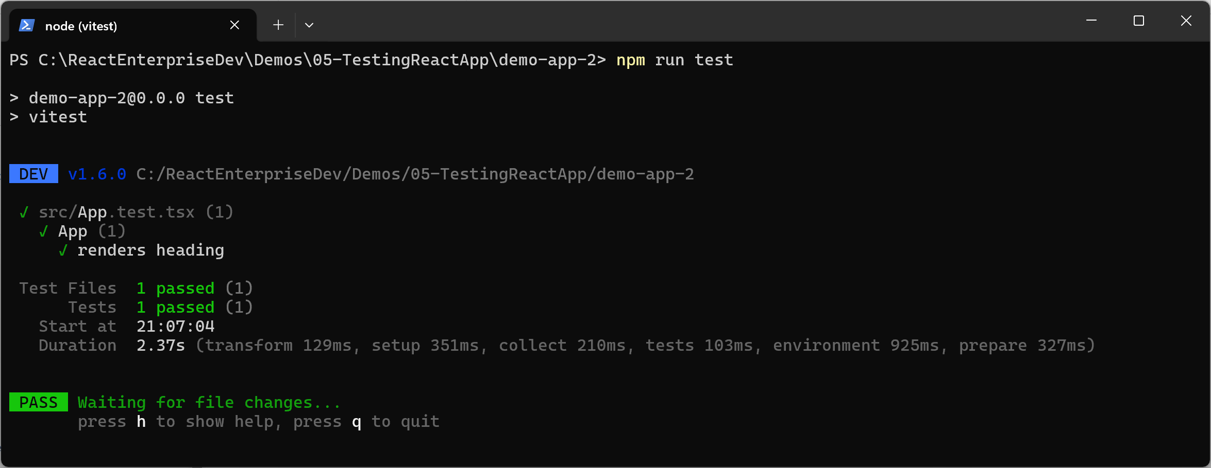
Running the Tests
npm run test

Slide 29
Summary
Introduction to web testing
Getting started with Vitest
Using Vitest to test React applications

